Slide 1

Humphries Elementary School

Slide 2
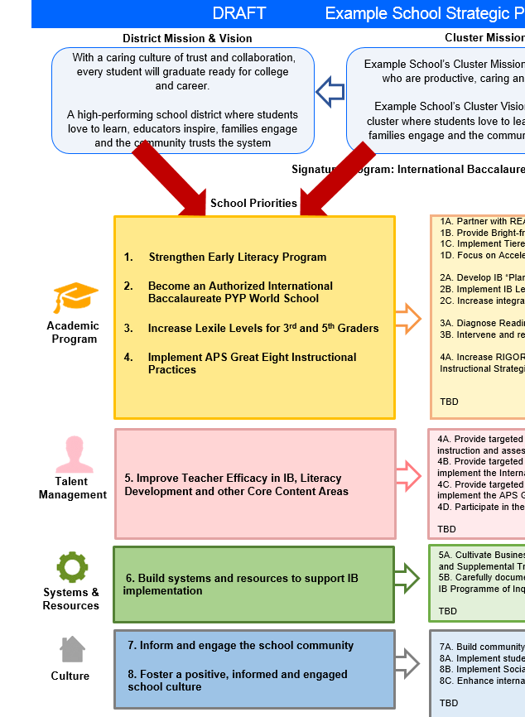
FY19 Budget Development Process
The GO Team will ensure that the budget is aligned to the school’s mission and vision and that resources are allocated to support key strategic priorities.
Notes:
Key Take Away Message

Slide 3

GO Team Budget Development Process
YOUR SCHOOL STRATEGIC PLAN…
is your roadmap and your role. It is your direction, your priorities, your vision, your present, your future.
Step 1: Data Review
Step 2: Strategic Plan Review
Step 3: Comparison
Step 4: Budget Parameters
Step 5: Budget Choices

Slide 4
What’s Next?
• February:
  One-on-one Associate Superintendent discussions
  Cluster Planning Session (positions sharing, cluster alignment, etc.)
  Program Manager discussions and approvals
  GO Team Approve Draft School Budget
  Academic and Staffing Resource Planning Meeting (February 26th - March 2nd)
• March:
  Final GO Team Approval (March 5th - March 9th)

Slide 5
Focus Area Descriptors
Strategic Plan Categories | District Descriptions of Categories
Academic Program | Our students will be well-rounded individuals who possess the necessary academic skills and knowledge and are excited about learning.
Talent Management | We will retain an energized and inspired team of employees who are capable of advancing ever-increasing levels of achievement for students of all backgrounds.
Systems & Resources | We will improve efficiency (productivity, cost, etc.) while also making decisions (including resource allocations) that are grounded in a strategic academic direction and data.
Culture | We will build trust with the community, and we will have engaged stakeholders (employees, students, parents, community members, partners, etc.) who are invested in the mission and vision and who support the creation of student-centered learning communities.

Slide 6

Description of Strategy Categories
Budget Parameters – FY19 funding priorities from the school’s 3-5 year strategic plan, ranked by the order of importance
Strategies – Lays out specific objectives for schools improvement
Request – “The Ask”. What needs to be funded in order to support the strategy?
Funding Source – What source of funds will finance the request (i.e. general, cluster, signature, Title I)

Slide 7
Executive Summary
This budget represents an investment plan for our school’s students, employees and the community as a whole.
The budget recommendations are tied directly to the school’s strategic vision and direction.
The proposed budget for the general operations of the school are reflected at $3,680,744
This investment plan for FY19 accommodates a student population that is projected to be 297 (-7) students.

Slide 8
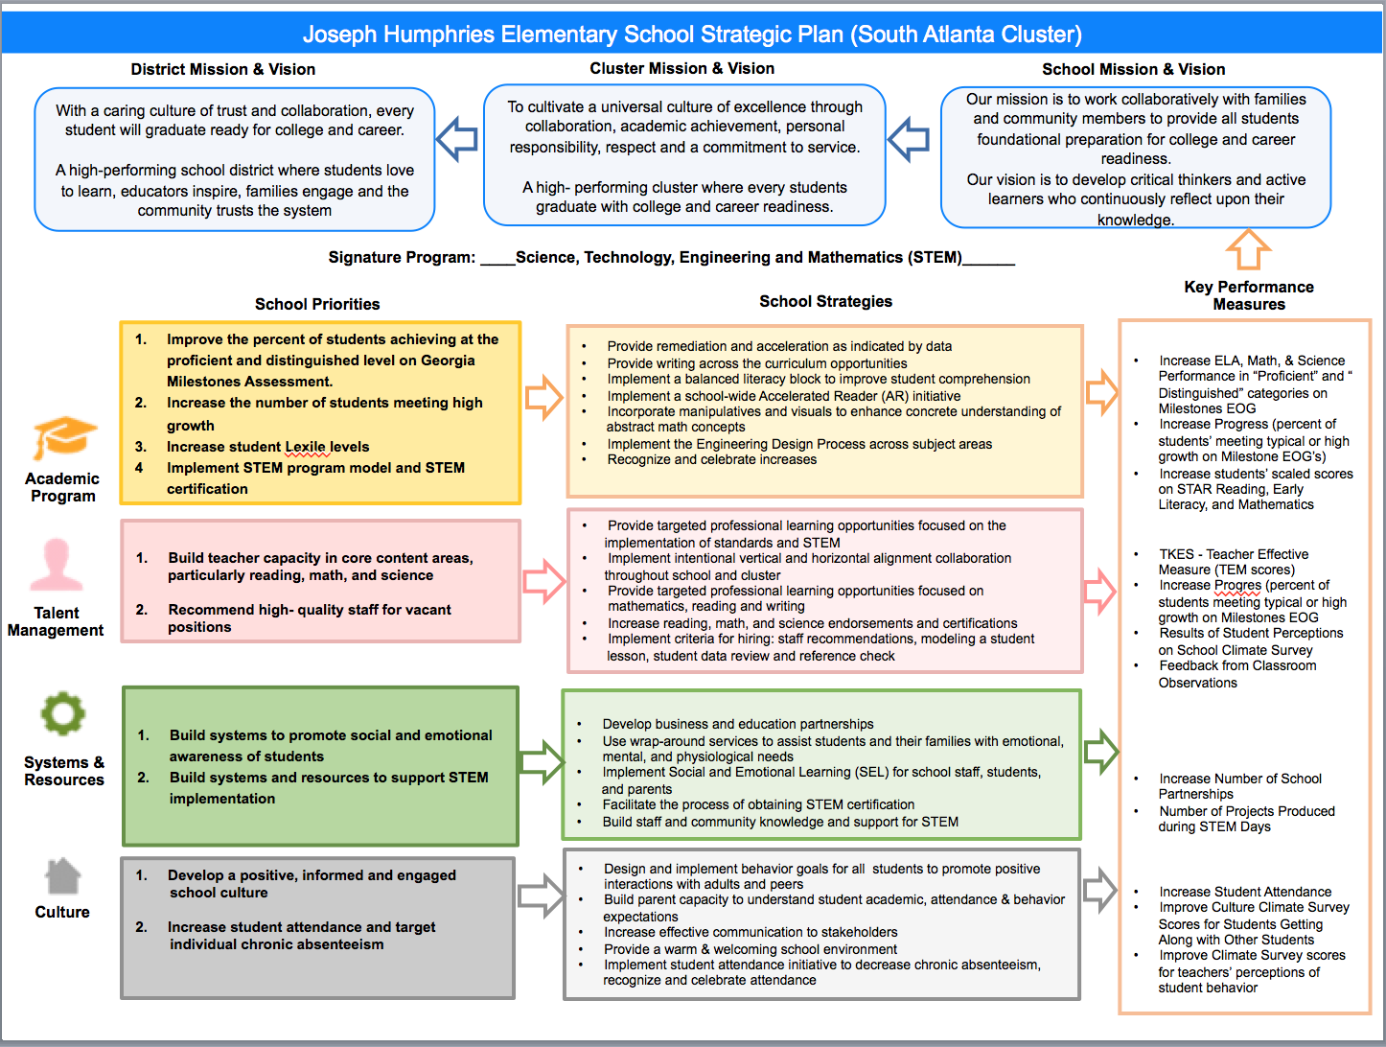
(Humphries) FY19 Strategic Plan
(Insert Copy of Strategic Plan Here)

Slide 9
FY19 Budget Parameters
FY’ 19 School Priorities | Rationale
Build teacher capacity in core content areas particularly reading, math, and science | Increase the percentage of students scoring proficient or distinguished on Georgia Milestones and increase the percentages of students achieving high growth levels of mastered standards
Implement STEM program and STEM certification | Align with the South Atlanta Cluster signature program

Slide 10
Discussion of Budget Summary
(Step 5: Budget Choices)

Slide 11

FY19 Projected Enrollment | Weighted For:
264 | Grade Level Kindergarten 1st 2nd 3rd Poverty Special Education Gifted Gifted Supplement ELL Small School Supplement
Example
Total Earned | Total Used
$4,124,518 | $4,124,518

Slide 12
School | Humphries Elementary School
Location | 5562
Level | ES
Principal | Ms. Melanie Mitchell
Projected Enrollment | 295
 |  | Used
 |  | FTE | Budget
1000 | Instruction | 33.00 | $2,732,243
2100 | Pupil Services | 0.75 | $101,845
2210 | Improvement of Instructional Services | 2.00 | $197,741
2213 | Instructional Staff Training | - | $12,500
2220 | Educational Media Services | 1.00 | $104,914
2400 | School Administration | 4.00 | $373,526
2600 | Maintenance & Operations | 2.50 | $125,528
2700 | Transportation | - | $2,500
Total |  |  | $3,650,797

Slide 13
Example

Slide 14
FY19 Strategic Plan Break-out
Priorities | Focus Area | Strategies | Requests | Funding Sources | Amount
Build teacher capacity in core content areas particularly reading, math, and science | Talent Management | Increase reading , math and science endorsements and certifications | Funding for staff development/gaining credentials | Title 1 General Funds | Use holdback money $10,000*
Build teacher capacity in core content areas particularly reading, math, and science | Talent Management | Provide targeted professional learning opportunities focused on the implementation of standards and STEM | School visits, substitute teachers, Quarterly Data PLCs | Title 1 | Use holdback Money $6,075
* Training funds may be transferred to contractor fees if in house training done

Slide 15
FY19 Strategic Plan Break-out
Priorities | Focus Area | Strategies | Requests | Funding Sources | Amount
Implement STEM program and STEM certification | Academic | Provide writing opportunities across the curriculum | Outside Vendor for Scoring of Formal Writing Prompts, Purchase an additional paraprofessional for small group instruction, coverage, ) | General Funds | $5,229 $25,000*
Implement STEM program and STEM certification | Academic | Implement the engineering design process across subject areas | purchase STEM materials for building models (batteries, wire, motors, robotics materials, etc), STEM in school/away from school field trips, transportation | General Funds | $5000 $5000 $2000
*Parent Liaison position abolished

Slide 16
Questions to Consider
Are our school’s priorities (from your strategic plan) reflected in this budget?
  What new positions or resources are we budgeting for to address our major priorities?
  How do we plan to support implementation of these priorities beyond the budget?
  What tradeoffs will we make in order to support these priorities?
2. How are district and cluster priorities reflected in our budget?
  Cluster priorities- what staff, materials, etc. are dedicated to supporting our cluster’s priorities?
  Signature programs- what staff, materials, etc. are dedicated to supporting our signature program?
  Are there positions that our school can share with another school, i.e.

